Slide 1
Artificial Intelligence
By: Saúl Alonso Nuño Sánchez

Slide 2
Definition
Artificial intelligence is considered a branch of computation and relates a natural phenomenon to an artificial analogy through computer programs. Artificial intelligence can be taken as a science if it focuses on the elaboration of programs based on comparisons with human efficiency, contributing to a better understanding of human knowledge.
2

Slide 3
Definition
Ability of computer programs to operate in the same way that human thought executes its learning and recognition processes.
Simulation of human intelligence in a machine.
3

Slide 4
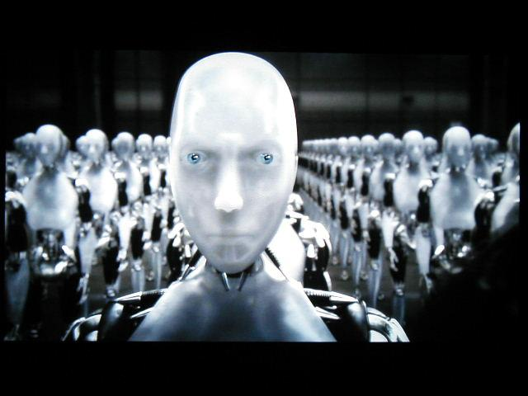
Definition
Depende del autor:
Systems that think like humans (Neural Networks).
Systems that act like humans (Robotics).
Systems that think rationally (Expert Systems ).
Systems that act like rationally.
4

Slide 5
Definition
The automation of activities that we link to the human thinking process, such as decision making, problem solving, learning … (Bellman, 1987)
The branch of computer science that deals with the automation of intelligent behavior (Luger y Stubblefield, 1993)
5

Slide 6
Objective
Build programs to solve "hard" problems:
Problems where does not exist a single solution.
They require enormous amounts of information.
They must deal with incomplete, confusing or even contradictory information.
6

Slide 7
Problems addressed by AI
Common sense reasoning
Perception (vision, speech)
Natural language processing.
Medical Diagnosis
Chemical analysis.
Pattern recognition.
Optimization.
Robotics.
7

Slide 8
Heuristic Search
A trick or strategy that greatly limits the search for solutions to large problem spaces. Therefore, when faced with a problem, it helps us to select the bifurcations, within a tree, with the most possibilities, thereby restricting the search, although an adequate solution is not always guaranteed. All that is necessary for a heuristic to be adequate is that it provides us with solutions that are good enough. In addition, by using heuristics, it will not be necessary to restate a problem each time it is faced, since if we have previously posed it, it will suggest the way in which to proceed to solve it.
8

Slide 9
Heuristic Search
In finance, the use of this type of algorithms is frequent in optimization problems, where it is required to maximize/minimize one or several variables, which depend on the problem being analyzed.
The complexity lies in the amount of data and variables.
9

Slide 10
Examples of heuristic methods
Genetic Algorithms (GA)
Particle Swarm Optimization (PSO)

Slide 11
Genetic Algorithms
By: Abraham Oceguera Gómez
Saúl Alonso Nuño Sánchez

Slide 12
Objective
Solve optimization problems using Genetic algorithms

Slide 13
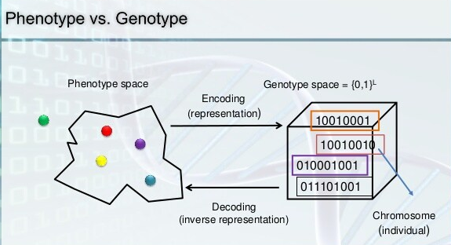
Glossary
Algorithm: series of mathematical steps, especially in a computer program, which will give you the answer to a particular kind of problem.
Heuristic: in the context of computer programs, this term refers to rules based on previous experience in order to solve a problem, rather than using a mathematical procedure.
Genotype: it refers to the genetic constitution (codification) of an individual or organism.
Phenotype: in the context of programming, it refers to decodification

Slide 14
Introduction
Creator: John Holland (Adaptation in Natural and Systems, 1975).
Imitate adaptative process of natural systems.
Design artificial systems (programs) that allow to retain mechanisms of natural systems.
Are inspired in biologic evolution and natural selection.
Important people: K. DeJong y D. Goldberg (1989), Davis (1991), Michalewicz (1992), Reeves (1993)
14

Slide 15
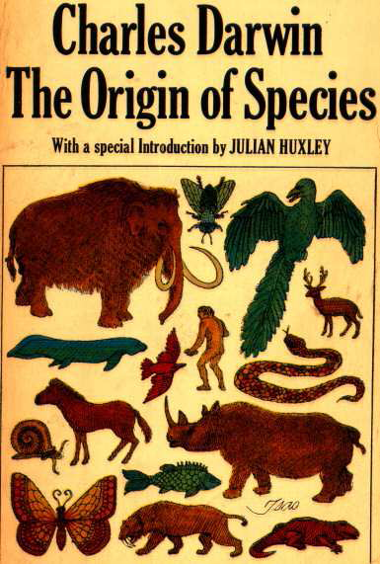
Introduction
Characteristics of Genetic Algorithms (GA):
Are probabilistic (The output of the algorithm could be different each is applied to the same data).
Are Heuristics (Could achieve good solutions).
Are based on natural selection and genetic (Darwing 1859).
Widely used in discrete Optimization.
GA are not too fast.
GA allow to do parallel search.
15

Slide 16
Advantages
Are robust.
GA can be applied to non continuous functions.
With GA different kind of problems can be solved: with big dimensions, lineal, no lineal, multi objective, with noise or dependent on time.
GA work well with discrete variables.
16

Slide 17
Disadvantages
A wrong definition of the objective function leads to bad results as well as a wrong codification.
Premature convergence produced by a super individual.
A bad selection of parameters could lead to bad solutions (not as good as we expected).
AG provide slower solution than if the problem can be tackled by an analytic way.
17

Slide 18
How to know when to use GA?
The search space (possible solutions) is limited by a finite range.
The fitness function (how good or bad is the solution) must be defined by an equation.
Solutions must be codified in a simple way in order to be implemented in a computer code.
18

Slide 19
Applications
Optimization
Automatic programming
Machine learning
Economy and Finance
Immune systems
Ecology
Genetic of Population
Evolution and learning
Social systems
19

Slide 20
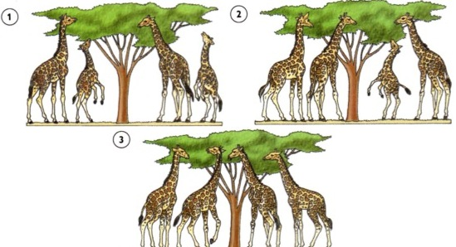
GA (How does it works?)

Slide 21
GA (Functioning)
Generate initial population.
Evaluate each member of the population (individual).
Select progenitors.
Crossover progenitor to generate new individuals (Sons).
Mutate sons (Randomly).
Create a new population with the selected progenitors and their descendants.
Iterate step 2 to 6 until the stop criteria is reached.

Slide 22
GA components
Adequate Codification.
Initial population.
Fitness function.
Evolutionary operators.
Input parameters value.
22

Slide 23
GA
Let P(t) the population at time t and C(t) the set of new individuals, the general structure of a GA could be:
1: t←0; //Initial population
2: Initialize P(t);
3: evaluate P(t);
4: while (establish ending condition) do
5: Select parents P(t)
6: Crossover parents and mutate sons ⇒ C(t);
7: Evaluate C(t);
8: Select survivors de P(t)∪C(t)⇒P(t+1); /*Generational substitution*/
9: t←t+1; /* Next generation*/
23

Slide 24
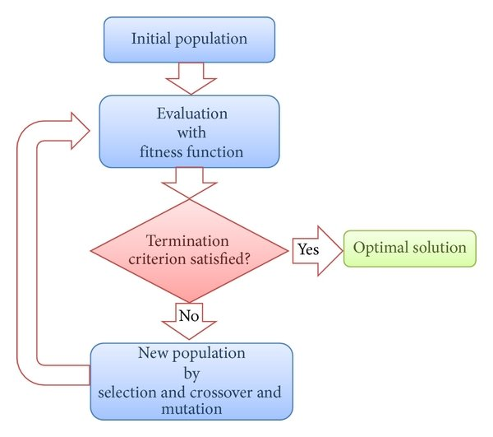

Slide 25
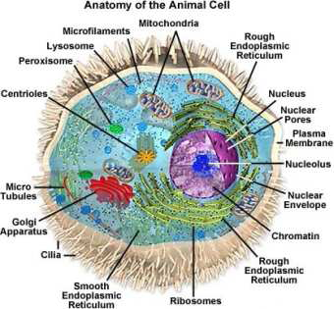
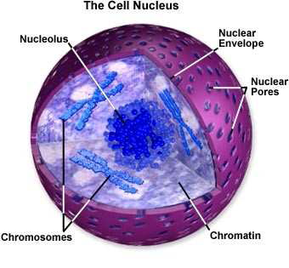
GA representation
The solutions of a GA are called string, structure o chromosome.
Usually this solutions are codified with binary numbers.
25

Slide 26
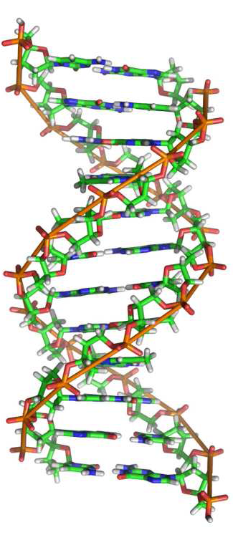


GA representation
Genotype is the codification of the individuals.
Phenotype: Decodification of the individuals
A genotype, in the chromosome, in the generation t could be represented as:
with
26

Slide 27

GA representation
The term individual denotes the set of information genotype-phenotype-fitness.
The individual at time (generation) t is represented by the tripled:
27

Slide 28


Initial population
Input parameter for a GA, which is a set of m individuals. If the coding is binary, assign a random value between 0 and 1 to each gene in the chromosome.
Fitness function
It consists of evaluating the phenotype through the objective function f of the problem being solved.
28

Slide 29
GA operator
Selection
Crossover
Mutation
29

Slide 30

Selection
Transmit and preserve the characteristics of value solutions.
The individuals were no selected are eliminated.
Types:
Roulette (proportional selection)
By Ranking
By Tournament
28

Slide 31
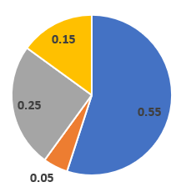
Roulette
 |  | Probability
x | f(x) | p | cumulative
5 | 55 | 0.55 | 0.55
2 | 5 | 0.05 | 0.6
7 | 25 | 0.25 | 0.85
0 | 15 | 0.15 | 1
Total | 100

Slide 32
Crossovers
This operation allows to Exchange the genetic information stored in the selected population (parents) in order to create better individuals.
One point crossover
Two points and n points crossover
Uniform crossover
Arithmetic crossover
Permutation crossover
29

Slide 33
Mutation
Apply to each son the mutation operator
In a simple mutation, only one gen (bit) is changed from 0 to 1, o viceversa with a probability p_{mut.}
Some ideas:
Change one bit randomly
Exchange a pair of bits.
30

Slide 34
Generational Substitution
In a Simple GA the complete generational substitution used. In this case the selected parents and their sons replace to the previous generation.
34

Slide 35
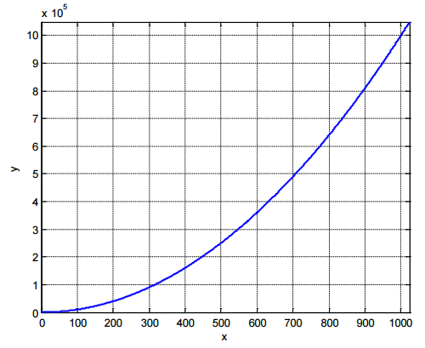
Example
Determine the maximum value of the function y=x²
X=[0,255]
x∈X
32

Slide 36
Initial population
 | Initial Population (Phenotype) | Codification (Genotype) | f(x) Value (Fitness function)
1 | 18 | 00010010 | 324
2 | 78 | 01001110 | 6084
3 | 232 | 11101000 | 53824
4 | 186 | 10111010 | 34596
5 | 66 | 01000010 | 4356
6 | 9 | 00001001 | 81
7 | 27 | 00011011 | 729
8 | 126 | 01111110 | 15876
 |  | Sum Average The Best | 115870 14483.75 53824
36

Slide 37
Selection
 | Initial Population (Phenotype) | Codification (Genotype) | f(x) Value (Fitness function)
1 | 18 | 00010010 | 324
2 | 78 | 01001110 | 6084
3 | 232 | 11101000 | 53824
4 | 186 | 10111010 | 34596
5 | 66 | 01000010 | 4356
6 | 9 | 00001001 | 81
7 | 27 | 00011011 | 729
8 | 126 | 01111110 | 15876
 |  | Sum Average The best | 115870 14483.75 53824
37

Slide 38
One point Crossover
 | Initial Population (Phenotype) | Codification (Genotype) | The sons
3 | 232 | 01000 | 11111010
4 | 186 | 11010 | 10101000
8 | 126 | 011 11110 | 01101110
2 | 78 | 010 01110 | 01011110
38

Slide 39
Mutation
 | Initial Population (Phenotype) | Codification (Genotype) | The sons
3 | 232 | 01000 | 11111010
4 | 186 | 11010 | 10101000
8 | 126 | 011 11110 | 01101110
2 | 78 | 010 01110 | 11011110
39

Slide 40
New generation (sons+parents)
 | Initial Population (Phenotype) | Codification (Genotype) | f(x) Value (Fitness function)
1 | 232 | 01000 | 53824
2 | 186 | 11010 | 34596
3 | 126 | 011 11110 | 15876
4 | 78 | 010 01110 | 6084
5 | 250 | 11111010 | 62500
6 | 168 | 10101000 | 28224
7 | 110 | 01101110 | 12100
8 | 222 | 11011110 | 49284
 |  | Sum Average The best | 262488 32811 62500
40

Slide 41
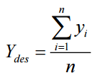
¿How to know if the GA is working well?
The most common way is using the average performance of the population to evaluate the performance of the GA
41

